Slide 1
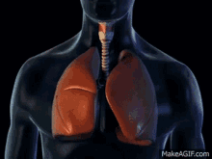

Positioning to Optimise Gas Exchange
Stuart Clarke
Highly Specialist Physiotherapist
Harefield Hospital

Slide 2

Learning Outcomes
Practically apply theory to maximise V/Q ratio in patients
Develop a theoretical understanding of the differences in ventilation and perfusion throughout the lungs (V/Q)
Differentiate between self-ventilating and ventilated adults
Understand the physiological effects of positioning

Slide 3
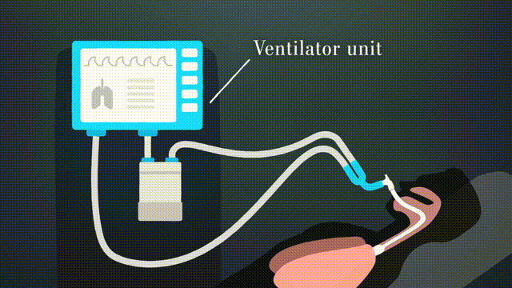
Physiological Effect of Positioning
Has profound acute effects on
Cardiovascular and cardiopulmonary function
Influences oxygen transport
Improved gas exchange
Reduced supplementary oxygen
Reduced pharmacological support
Reduced ventilatory support
(Burns & Jones, 1975; Dean, 1985)

Slide 4
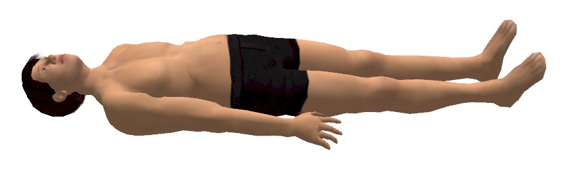
Supine Position
Negative effects well documented but still frequently used (Dean & Ross, 1992)
Reduced flow rates
Increased work of breathing (Craig et al., 1971)
Airway closure and reduced PaO₂ (Ray et al., 1974)
Reduced lung volumes

Slide 5
Positioning Supine to Upright increases:
Total lung capacity
Tidal volume (V_{T})
Vital capacity (VC)
Residual volume (RV)
Functional residual capacity (FRC)
Forced expiratory flow
Lung compliance
PaO₂
AP diameter of chest
Diaphragmatic excursion
Mobilisation of secretions
Lymphatic drainage

Slide 6
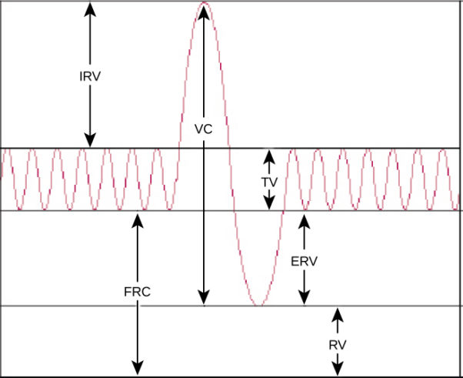
Lung Volumes
TLC (Total Lung Capacity): The total amount of air in the lungs after a full inspiration
TV (Tidal Volume): The volume of air moving into or out of the lungs during a normal breath
RV (Residual Volume): The amount of air left in the lungs when expiration is complete
VC (Vital Capacity): The maximal amount of gas which can be expired from TLC to RV gently (or inspired)
FRC (Functional Residual Capacity): The amount of air remaining in the lungs after a normal passive exhalation
ERV (Expiratory Reserve Volume): The extra volume of air that can be expired with maximum effort beyond the level reached at the end of a normal tidal volume expiration
IRV (Inspiratory Reserve Volume): The volume of air that can be inhaled forcefully after normal tidal volume inspiration
CV (Closing Volume/Capacity): The volume of air at which small basal airways start to close on expiration
TLC

Slide 7
Positioning Supine to Upright decreases:
Airway closure
Airway resistance
Work of breathing
Work of the heart
Pulmonary vascular congestion
Central venous pressure
Central blood volume

Slide 8
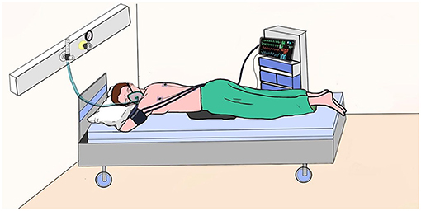
Prone Position:
Improved lung compliance secondary to stabilisation of the anterior chest wall
Improved diaphragmatic excursion
Increased FRC
Reduced airway closure
Improved PaO₂
(Dean, 1985; Pelosi et al, 1998)

Slide 9
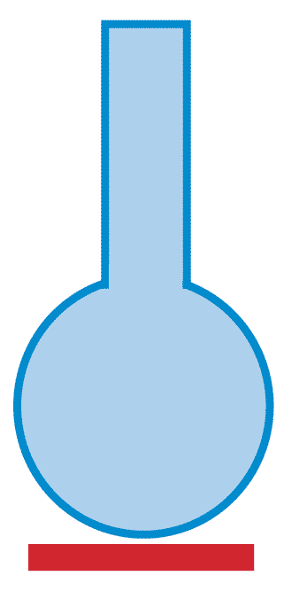
Ventilation/Perfusion (V/Q) Matching
V
For efficient gas exchange there needs to be a close match between:
Alveolar ventilation (V)
Alveolar perfusion (Q)
Alveolar gas
Q
Capillary flow

Slide 10

V/Q Mismatch
V
Normal perfusion
Abnormal ventilation
Occurs in the presence of airway obstruction e.g. increased sputum production in pneumonia
Alveolar gas
Q
Capillary flow
Alveolar gas
Q
Capillary flow

Slide 11
V/Q Mismatch
V
Normal ventilation
Abnormal perfusion
e.g. pulmonary embolism
Alveolar gas
Q
Capillary flow
Alveolar gas
Q
Capillary flow

Slide 12

Autoregulatory Mechanisms
Hypoxic Pulmonary Vasoconstriction
Occurs in regions of poorly ventilated alveoli
Matching of poor Q to poor V
Diverts blood to better ventilated alveoli
Can become chronic and widespread leading to increased resistance to blood flow and right heart failure
Cor Pulmonale
The Bronchial Response
Sensitive to CO₂
Bronchodilation in the presence of high CO₂
Bronchoconstriction in the presence of low CO₂
Normalising CO₂ levels
Pulmonary Vasodilation
Occurs in areas where ventilation is good
Arterioles dilate
Matching good V to good Q
Notes:
In addition to positioning, the body will try and compensate for a V/Q mismatch

Slide 13
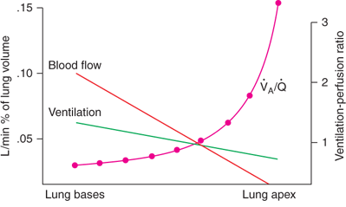
V/Q Throughout the Upright Lung
(West, 2012)
Notes:
In the absence of pathology, V and Q vary throughout the upright lung. Ventilation increases slowly from the top to the bottom of the lungs whereas blood flow increases more rapidly

Slide 14
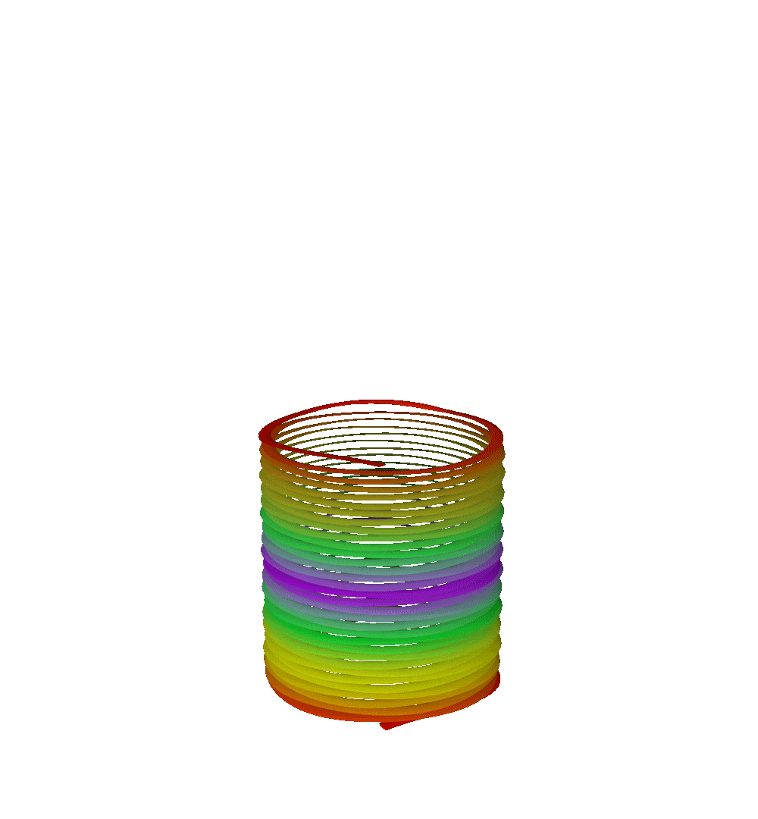
Causes of regional differences in ventilation:
Intra-pleural pressure
This is the pressure within the pleural cavity
Intra-pleural pressure is negative to intra-alveolar pressure allowing alveoli to expand
Spontaneous ventilation = negative pressure ventilation
Intra-pleural pressure higher (less negative) at the bases due to the weight of the lungs in an erect posture
The lungs are squashed under their own weight and contained inferiorly by the diaphragm and underlying abdominal organs
Notes:
Anything that is supported requires a larger pressure below it than above it to balance the downward acting weight forces

Slide 15
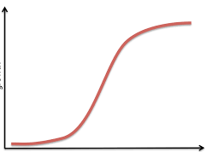
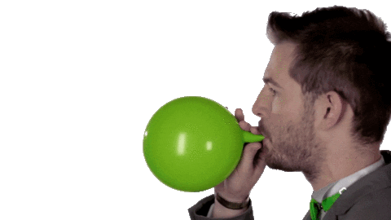
Causes of regional differences in ventilation:
V
Apex
Compliance
A measure of the ability of an object to yield elastically when a distending force is applied
Mid-zone
Base
P
Notes:
Use balloon and then slinky.
At the bases the lungs are slumped under their own weight and alveoli are squashed
Mid zones more compliant – balloon expands easier
Apex – the alveoli are stretched and held semi open
Ventilation is greater at the at the bases due to their being a smaller resting volume at the end of expiration and therefore a larger change in volume of air than the apex at the end of inspiration where the alveoli have a higher resting volume
A lower pressure is required to elicit a change in volume

Slide 16
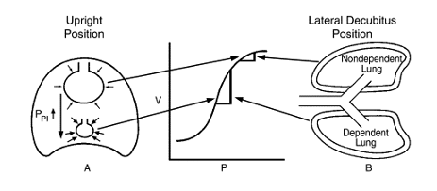
Dependent Lung
Dependent region of lung = the lowest areas of the lung, in relation to gravity
Where there is the most alveolar compliance
In upright position this is the middle to lower parts of the lung
In side lying (lateral decubitus position) this is the lower lung, because the hemidiaphragm is at a mechanical advantage due to the pressure of the abdominal contents

Slide 17
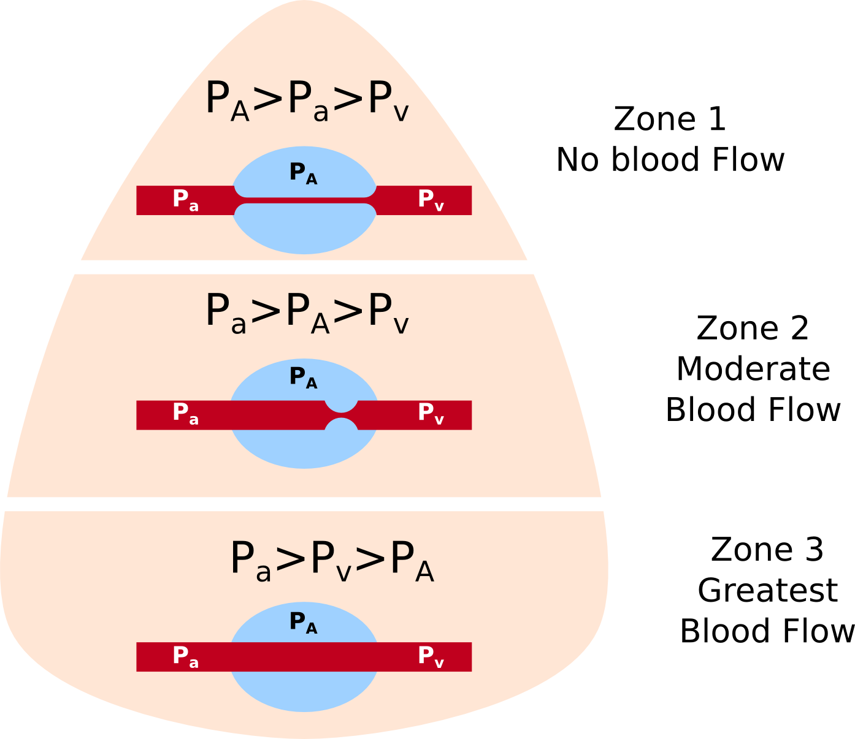
Regional Differences in Perfusion
P_{A} = Alveolar pressure
P_{a}= Arterial pressure
P_{v} = Venous pressure
(West, 2012)
Notes:
Blood flow increases from top to bottom with very low values at the apex
Hydrostatic pressure differences between blood vessels
Zone 1: Capillaries squashed flat but normally some blood flow unless haemorrhage or positive pressure
Random arrangement of blood vessels throughout the lungs
Affected by position and exercise
Centre better perfused than periphery
Affected by position in same way as ventilation

Slide 18
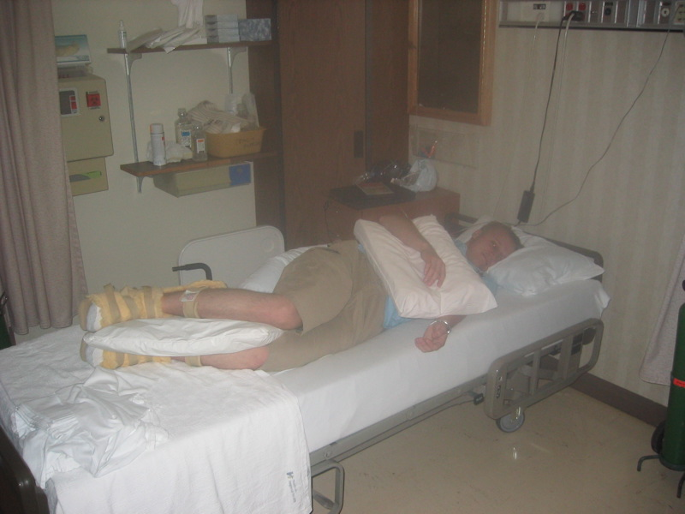
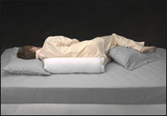
V/Q in a Self-Ventilating Adult
Dependent lung preferentially ventilated
Lower zones of the dependent lung preferentially perfused
Uni-lateral lung disease
Greatest benefit having the unaffected lung dependent (Remolina, 1981)
Drainage of secretions from the affected lung
Gravity will help to open atelectasis
Bilateral lung disease
Right lung dependent (Zach, 1974)
High sitting
Alternate side lying

Slide 19
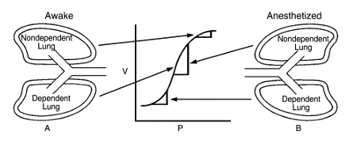
V/Q in a Ventilated Adult
Non-dependent lung preferentially ventilated
Diaphragm becomes passive
Positive pressure takes the path of least resistance
Dependent lung better perfused
V/Q mismatch!!!
Unilateral lung disease
Unaffected lung dependent
Supplementary oxygen, inspiratory pause and good minute ventilation counteract this
Drainage of secretions
High sitting
Bilateral lung disease
Alternate side lying
High sitting

Slide 20
Position for….
45 year old man with an unproductive left lower lobe pneumonia who is desaturating
25 year old women with a pulmonary embolism in her right middle lobe
78 year old man who is sedated and ventilated with left lower lobe collapse post cardiac surgery
35 year old lady who is sedated and ventilated with widespread COVID Pneumonitis

Slide 21
References
Burns, J.R. and Jones, F.L. (1975) “Early ambulation of patients requiring ventilatory assistance,” Chest, 68(4), p. 608. Available at: https://doi.org/10.1378/chest.68.4.608a
Craig, D.B. et al. (1971) “‘closing volume’ and its relationship to gas exchange in seated and supine positions.,” Journal of Applied Physiology, 31(5), pp. 717–721. Available at: https://doi.org/10.1152/jappl.1971.31.5.717
Dean, E. and Ross, J. (1992) “Discordance between cardiopulmonary physiology and physical therapy,” Chest, 101(6), pp. 1694–1698. Available at: https://doi.org/10.1378/chest.101.6.1694
Dean, E. (1985) “Effect of body position on pulmonary function,” Physical Therapy, 65(5), pp. 613–618. Available at: https://doi.org/10.1093/ptj/65.5.613.
PELOSI, P.A.O.L.O. et al. (1998) “Effects of the prone position on respiratory mechanics and gas exchange during Acute lung injury,” American Journal of Respiratory and Critical Care Medicine, 157(2), pp. 387–393. Available at: https://doi.org/10.1164/ajrccm.157.2.97-04023
Pryor, J.A. and Prasad, S.A. (2002) Physiotherapy for respiratory and cardiac problems: Adults and Paediatrics. Edinburgh, UK: Churchill Livingstone
Ray, J.F. (1974) “Immobility, hypoxemia, and pulmonary arteriovenous shunting,” Archives of Surgery, 109(4), p. 537. Available at: https://doi.org/10.1001/archsurg.1974.01360040055014

Slide 22
Remolina, C. et al. (1981) “Positional hypoxemia in unilateral lung disease,” New England Journal of Medicine, 304(9), pp. 523–525. Available at: https://doi.org/10.1056/nejm198102263040906
West, J. (2012) Respiratory physiology: The essentials. Ninth Edition. LWW
ZACK, M.B., PONTOPPIDAN, H. and KAZEMI, H. (1974) “The effect of lateral positions on gas exchange in pulmonary disease,” American Review of Respiratory Disease, 110, pp. 49–55. Available at: https://doi.org/10.1097/00132586-197510000-00005

